Slide 1

Capstone Project-1
Hotel Booking Analysis
Prepared By
Nitin Solanki (solankinitin1210@gmail.com)
Kashif Kamran (kashifkamran639@gmail.com)

Slide 2
Points of discussion
Problem Statement
To know variable in data
Preparing dataset for analysis
Hotel type wise Booking Analysis
Market segment wise Booking analysis
Distribution channel wise booking analysis
Month Wise Analysis
Country wise Analysis
Guest wise Analysis
Cancellation analysis
Conclusion

Slide 3
Problem Statement
Explore and analyze the given dataset (hotel booking.csv) which is contain the information for city hotels and resort hotels to discover important factors that govern the bookings.
We are looking for
What is the booking ratio between Resort Hotel and City Hotel?
Which is the busiest month for hotels?
From which country most guests come?
Which market segment and distribution channel have a higher booking ratio?
Which was the most booked accommodation type (Single, Couple, Family)?
How Many Bookings were cancelled?

Slide 4
Know your Data
After reviewing the data we found that
The given dataset contains booking information for a city hotel and a resort hotel.
It includes information such as booking time, length of stay, number of adults, children/babies, number of available parking spaces, among other things.
Given dataset contains a total 119390 number of rows and 32 columns
All the data types are in the required format only, and no need to convert or change the datatype.
There are total 4 columns containing the null values and We’ll decide what to do with these null value columns depending on the column’s importance
To perform EDA we need to find the columns which are important for our analysis and then we’ll only consider those columns for our analysis and ignore the remaining columns,
To decide which columns are important for analysis we have divided all the 32 columns/variables into 2 categories
1. Continuous
2. Categorical

Slide 5
1. Continuous variables are those non Repeating values mainly in integer or number format. We put the following variable in this list
Out of 12 Nos of Continuous variable we shortlisted to 2 variable which is dependent on the problem set and expecting high or medium relevance to the problem.
arrival_date_day_of_month, adults,
lead_time | stays_in_weekend_nights | previous_cancellations | days_in_waiting_list
arrival_date_week_number | stays_in_week_nights | previous_bookings_not_canceled | adr
arrival_date_day_of_month | adults | booking_changes | reservation_status_date

Slide 6
2. Categorical variables that can be subcategorized like month variable can be subcategorized in 12 different months. We put the following variable in this list
Out of these 20 variables, we found 10 variables that are dependent on the problem set and expect high or medium relevance to the problem.
hotel, arrival_date_month, children,
babies, country, market_segment,
distribution_channel, customer_type, is_canceled,
arrival_date_year
hotel | babies | is_repeated_guest | company
is_canceled | meal | reserved_room_type | customer_type
arrival_date_year | country | assigned_room_type | required_car_parking_spaces
arrival_date_month | market_segment | deposit_type | total_of_special_requests
children | distribution_channel | agent | reservation_status

Slide 7
Preparing the dataset for analysis
Before we start our analysis it is very important to prepare our dataset for analysis which contain 2 things
1. Deal with null values
In our initial analysis we found that total 4 columns have null values
Column Company has 94.3% of missing data and Column agent has 13.69%,
we will Simply drop the high missing value column, thing is Company is an independent Variable list but with 94% missing data variable has no use.
Column Country has 488 rows with null values comparing 488 to total numbers 0.5% so we will remove those rows only,
Variable children has four missing values we will fill with 0 value.
2. Add required column in the dataset
We need to add the date of arrival Column by joining the month, year, and date column and after that we'll get month-year column which is required to do month wise booking analysis
We need the total number of the guest by adding all the three columns adult, children and babies, this column is required for guest wise booking analysis

Slide 8

Let’s explore
Now we know all the important columns and our data is in the required format so we can start our analysis to do so we will take all the important variables one by one and get the answers to our questions
So Let’s Start our analysis

Slide 9
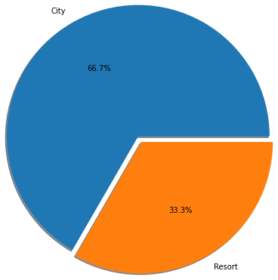
Hotel type wise Booking Analysis
We started our analysis with our first variable hotel, which represents the type of hotel for each booking, there is a total 2 types of hotel categories City hotel and resort hotel
In this analysis, we found that 66.4% of bookings are in City hotels and 33.6% which is half in Resort type.
Initial intuition is maybe the resort is comparatively expensive or location may affect the choosing priority.
But this is just an initial guess will see if this is backed by data or not, guess is completely based on assumption that city hotel as name suggests is utility kind of hotel available near around city only, On the other hand resort hotel can be remotely available and may have higher price comparatively.
if we go with the assumption of my own I can even think of some variables that can affect the booking phenomenon of different hotels resort hotels can be seasonal can have very high booking demand in certain months or occasions and on other hand city hotel may have even bookings.

Slide 10
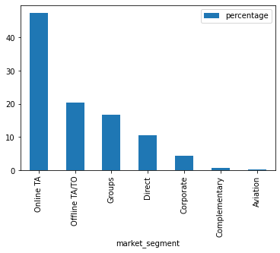
Market segment-wise booking analysis
Our second analysis is market segment-wise analysis, this column contains a total of 7 categories of the market segment.
To do this analysis group all the bookings by segment-wise and plot the resulted table with the bar chart
After plotting the chart we found that 67.5% of bookings are Done by Online/offline Tours and travels agents
We noticed that almost 50% bookings are done through online travels agents, this shows that proper prefer the to book instead of offline
Online channels segment are governing the booking over offline segment.

Slide 11
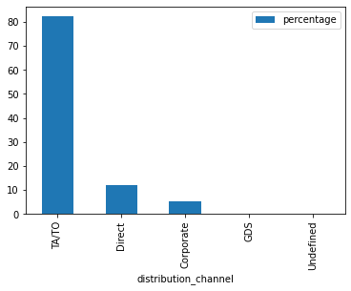
Distribution channel-wise booking analysis
Our Third analysis is Distribution Channel wise analysis, this column contains a total of 5 categories of Distribution Channels.
To do this analysis group all the bookings by Distribution Channel and plot the resulted table with the bar chart
After plotting the chart we found that 80% of bookings are Done by Online/offline Tours and travels agents
So people prefer to book through the third party instead of direct booking and reason could be service and better price (This is just prediction)

Slide 12
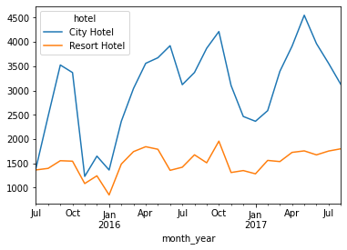
Month-wise booking analysis
Our next analysis is month-wise analysis, in this analysis we’ll see that which month of year get the most number of bookings compare to the other moths
In given data contains the booking details of 3 years 2015,2016,2017
In given data for the year 2015 booking details are given from month Jul to Decembers, but entries for month January to Jun are missing
Similarly for the month 2016 booking details are given from month January to July, but entries for month August to December are missing
So here we have not considered year-wise analysis instead of that we are doing the month wise analysis
To do this analysis we added a column by combining the month and year and the group the bookings by month-year the plotted the resulted table using the bar chart
From the chart we can see that no of bookings start increasing from the beginning of the month march and April and it has reached at its peak level and same curve occur for October.
We noticed the same booking behavior for both the hotel categories.
So we can conclude here that April, May, September, October are the busiest moth for booking

Slide 13
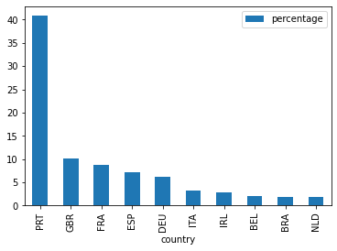
Country Wise Analysis
In country-wise analysis we have grouped all the bookings by country and get them plotted using the bar chart
Here we only plotted the top 10 countries from which guests have made the highest bookings
From the chart we can see that 40 percent bookings are done by guest from country Portugal(PRT), rest 30% bookings done by UK, Germany, France and Spain
So conclusion is more than 70 percent of booking govern by mainly 5 countries as mentioned above

Slide 14
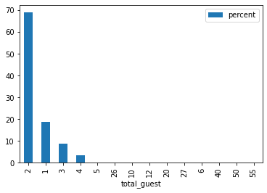
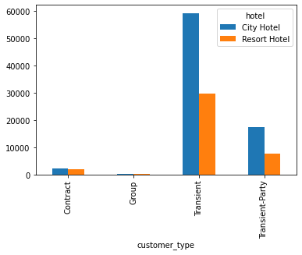
Guest Wise Analysis
We have divided this analysis into 2 categories
Accommodation type-wise analysis
In This analysis we'll to find which accommodation (Single, Couple, Family) have made the more booking
To get this analyses we grouped all the booking by total gust number wise and get it plotted
From the given chart we noticed that 68% of bookings made by couples and 18% bookings made by a single person and rest bookings are made by families of by a group of people
2. Customer Type wise analysis
In This analysis we'll to find what type of customer made the higher booking, as this column contains the 4 types of customers
To get this analyses we grouped all the bookings by customer type and get them plotted
From the given chart we noticed that Transient type of customers made the most no. of bookings

Slide 15
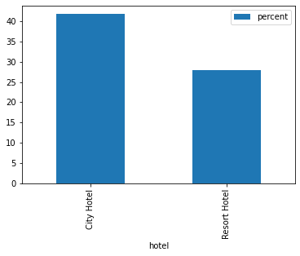
Cancellation Analysis
Finally we’ll do our last analysis which is cancelations analysis of booking
To do this analysis we have we user column Is_cancels
This column represents whether the booking is cancelled or not, It contains 0 nulls ,This column contains 2 types of data 0 and 1, 0 represent the not cancelled and 1 represent that booking is cancelled, we concluded this after reviewing column reservativion_status.
We got the chart of cancellation analysis by group 0 & 1 in columns is_cancelled and apply sum, from that chart we can see that City hotel have higher cancellation rate compared to resort hotel
For City hotels 41% bookings were cancelled after the booking where in case of resort hotel this percentage is 27%
So, City hotels have a higher booking ration and cancellation ratio too.

Slide 16
Conclusion
What is the booking ratio between Resort Hotel and City Hotel?
More than 66% of the people prefer to book the City hotel and only 33% people go with Resort hotels
Which is the busiest month for hotels?
Most bookings were made from July to August and September to October. And the least bookings were made at the beginning end of the year.
From which country do most guests come?
Portugal, UK, France, Spain and Germany are the top countries from which most guests come, more than 80% come from these 5 countries.
Which market segment and distribution channel have made the highest bookings?
Most bookings (50%) are done through online travels agents and for the distribution channel 80% of bookings were made by tours/travel agents
Which was the most booked accommodation type (Single, Couple, Family)?
Couple (No. of 2 guests) is the most popular accommodation type, 68% bookings were made by couples, also in terms of customer type Transient type customer has made most no. of bookings
How Many Bookings Were Cancelled?
City hotels 41% bookings were cancelled after the booking where in case of resort hotel this percentage is 27%

Slide 17
Thank You

